Slide 1

Adventure Sales Report
Main KPI’s, Time Series Analysis, Customer, Product, Regional Analysis

Slide 2
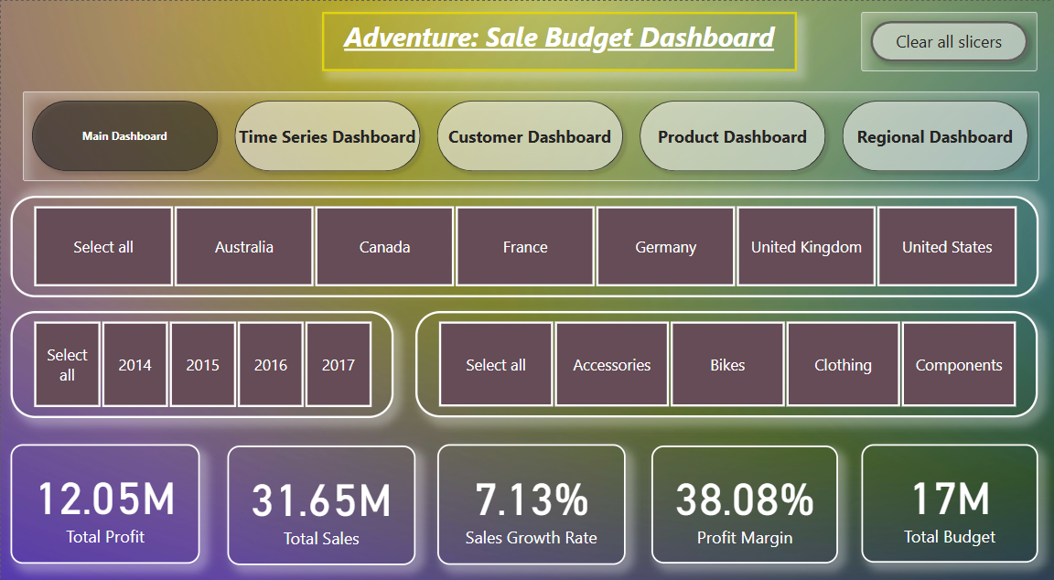
Adventure Works Sales
- Main KPI’s of Adventure Works Sales
- Neil Armstrong

Slide 3
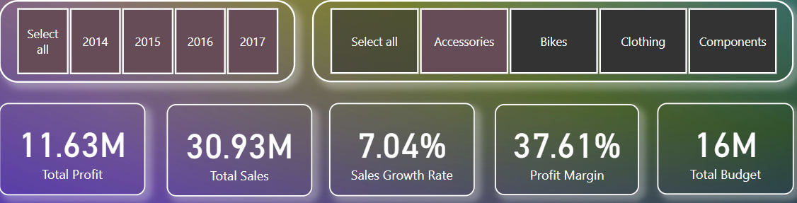
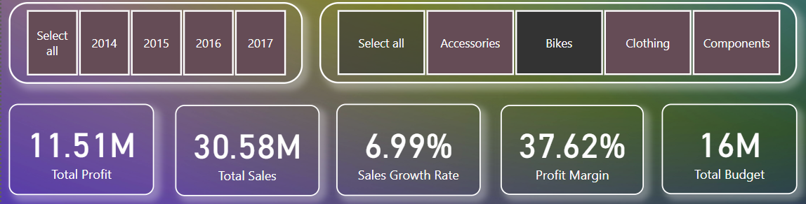
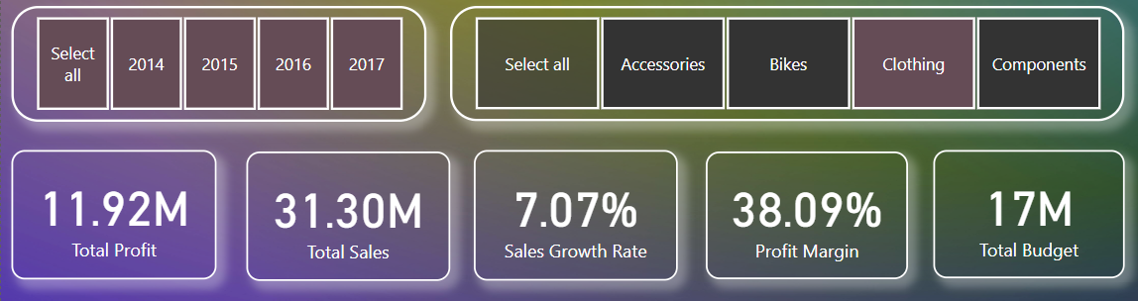
Adventure Works Sales Part 1
Accessories KPI’s
Bike KPI’s
Clothing KPI’s
- Neil Armstrong

Slide 4
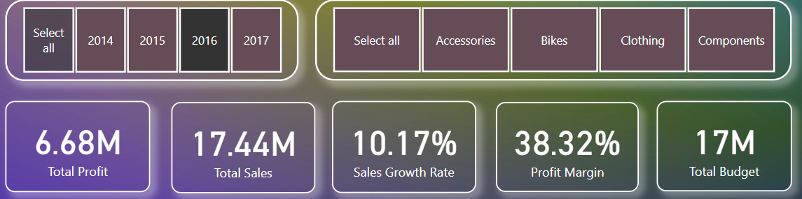
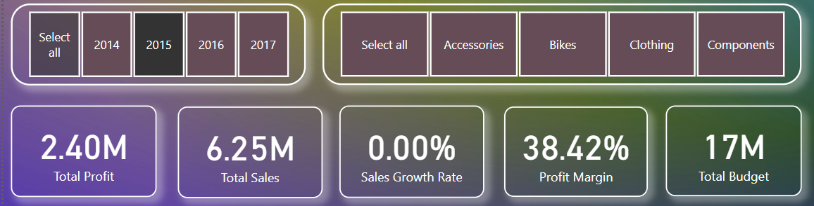
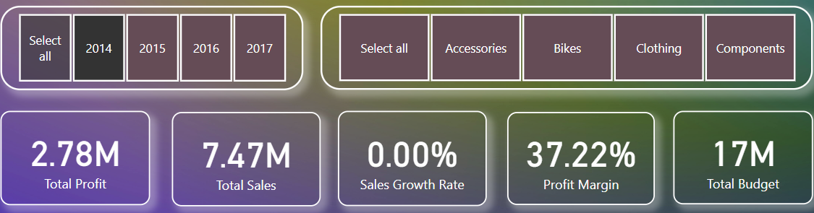
Adventure Works Sales Part 2
Higest Sales and Profits year was 2016
Then 2014 and 2015 as looks almost same Sales and Profits.
- Neil Armstrong

Slide 5
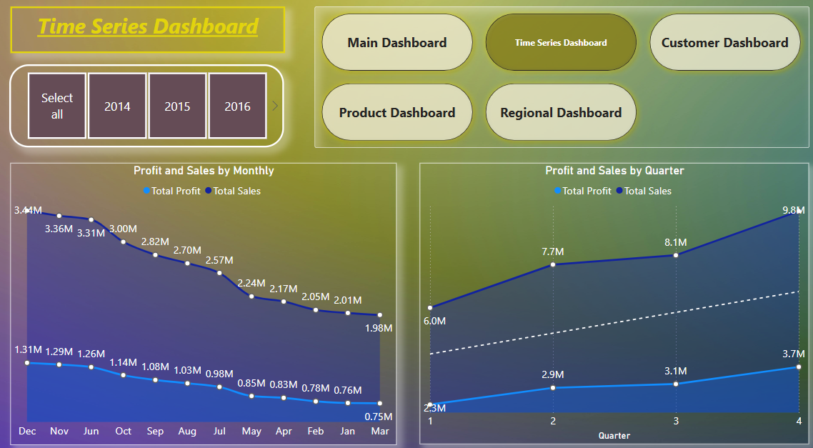
Time Series Analysis
Overview Sales and Profit for all Years.
- Neil Armstrong

Slide 6
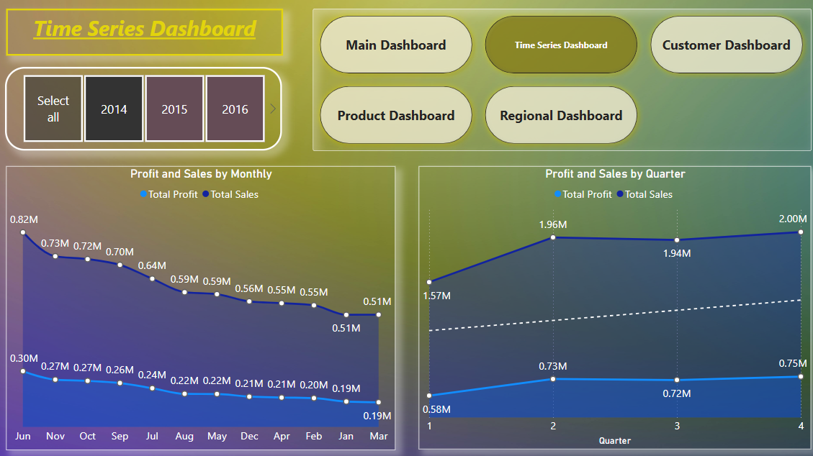
Time Series Analysis Part 1
- Year 2014, Sales and Profit for Monthly and Quatarly.
.
- Neil Armstrong

Slide 7
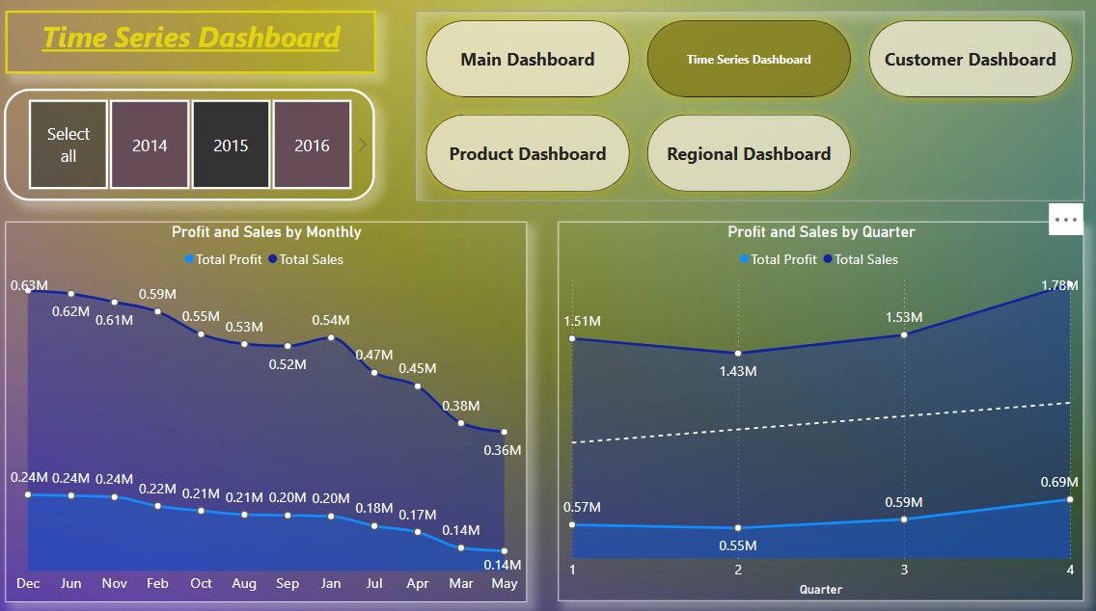
Time Series Analysis Part 2
- Year 2015, Sales and Profit for Monthly and Quatarly.
- Neil Armstrong

Slide 8
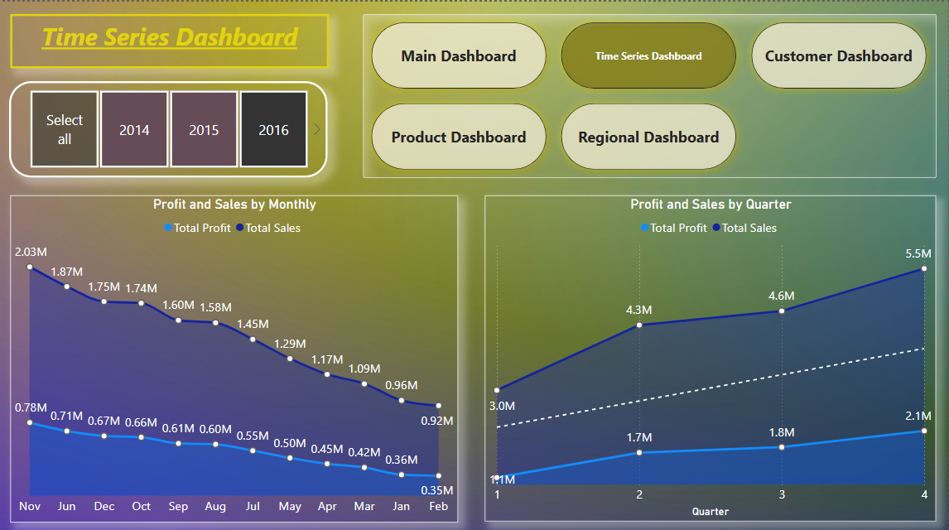
Time Series Analysis Part 3
- Year 2016, Sales and Profit for Monthly and Quatarly.
- Neil Armstrong

Slide 9
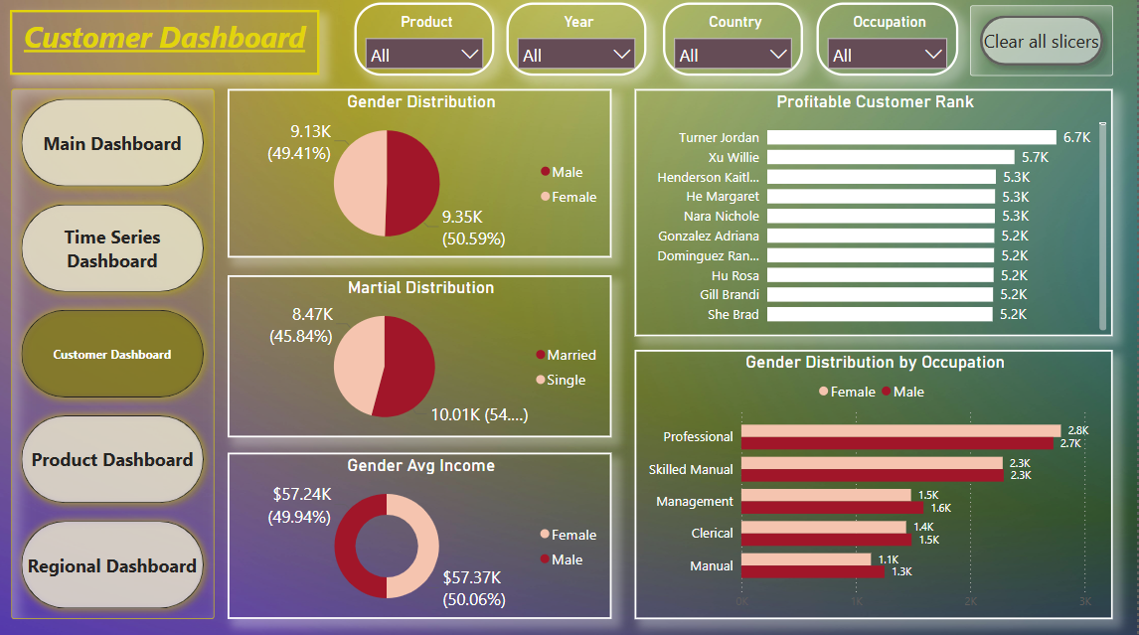
Customer Analysis
- Overview of Customer Analysis for all product, Years etc.
- Neil Armstrong

Slide 10
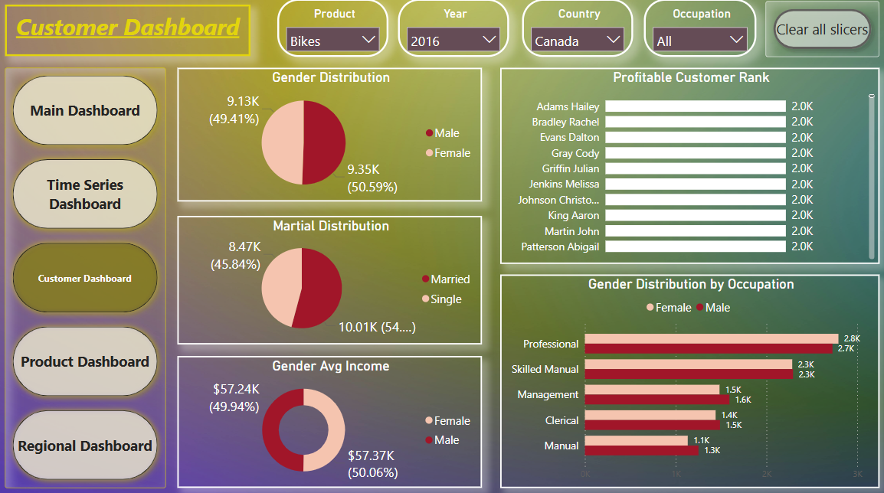
Customer Analysis Part 1
As there are no significant Distribution noticed in Gender, Martial, Avg Income for Product wise, Year wise, country wise in Customer Analysis.
- Neil Armstrong

Slide 11
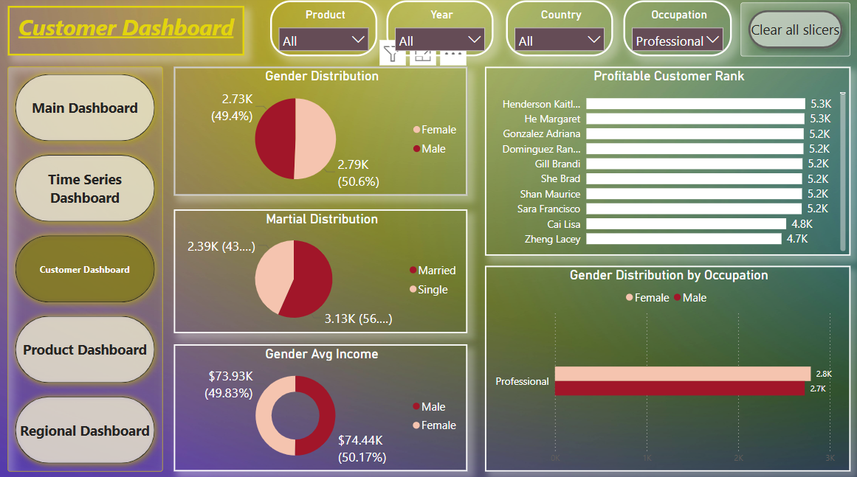
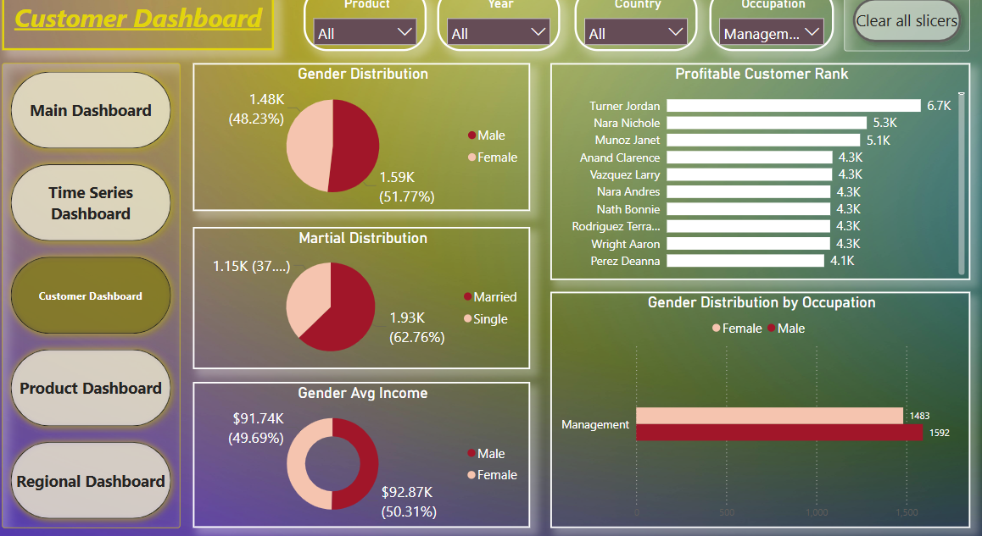
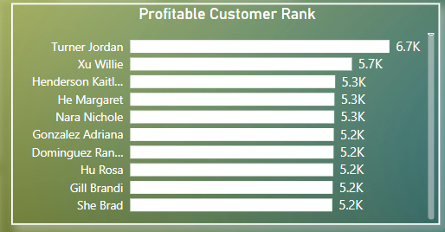
Customer Analysis Part 2
- As there are are significant Distribution noticed in Gender, Martial, Avg Income for Occupation wise in Customer Analysis.
- Also we have one customer that has most profitable customer is Turner Jordan.
- Neil Armstrong

Slide 12
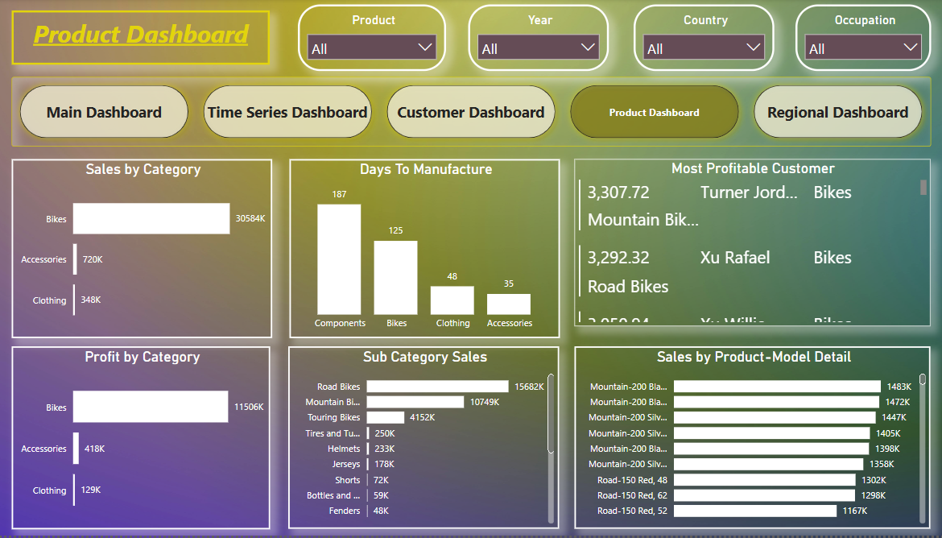
Product Wise Analysis
- Overview for Product wise Analysis.
- Neil Armstrong

Slide 13
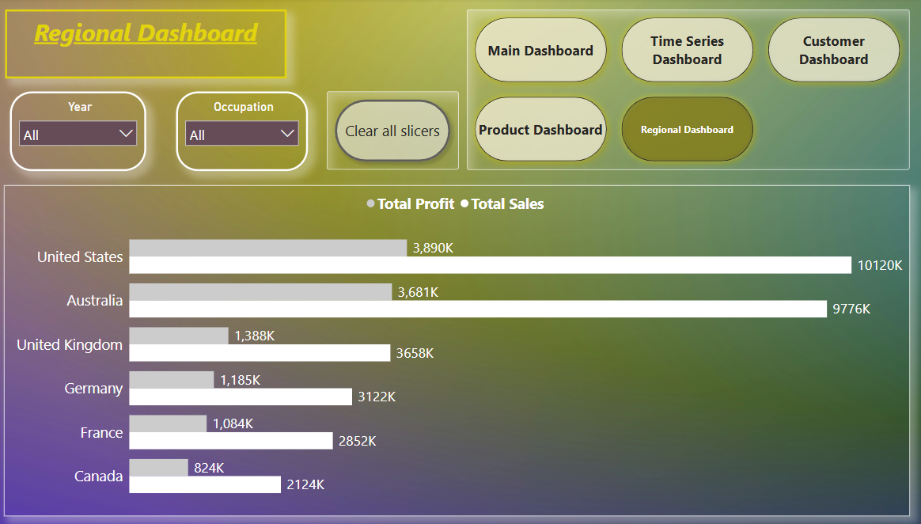
Regional Analysis
- Overview for Regional wise Analysis.
- Neil Armstrong

Slide 14
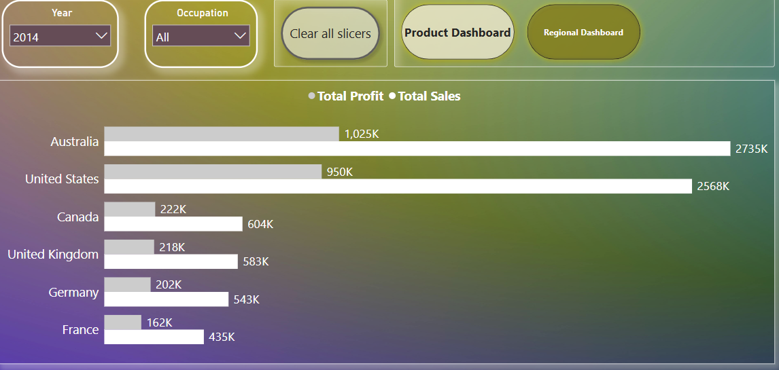
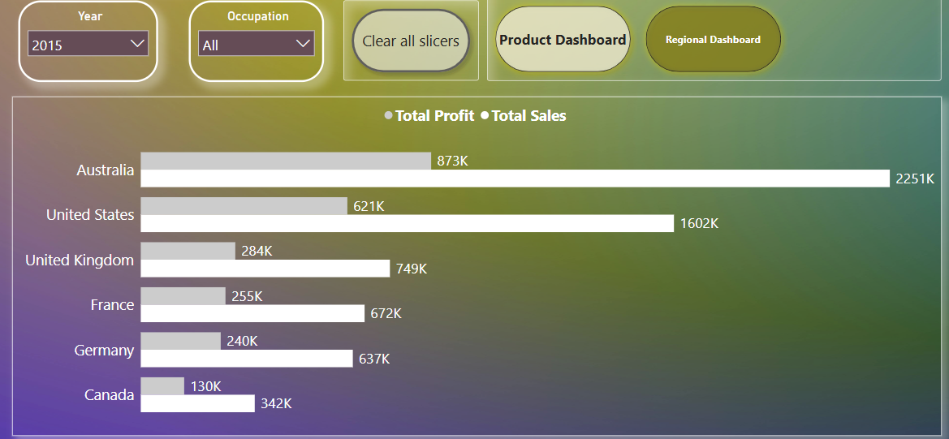
Regional Analysis Part 1
- 2014, 2015, Australia is highest sales and profit.
- Neil Armstrong

Slide 15
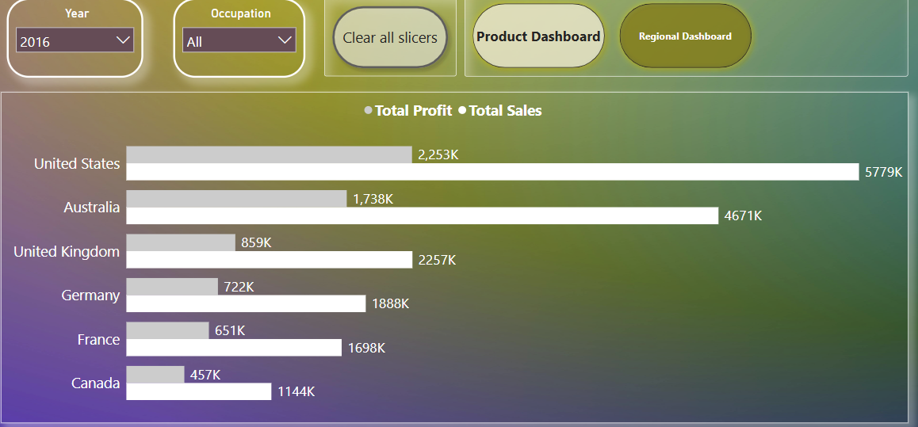
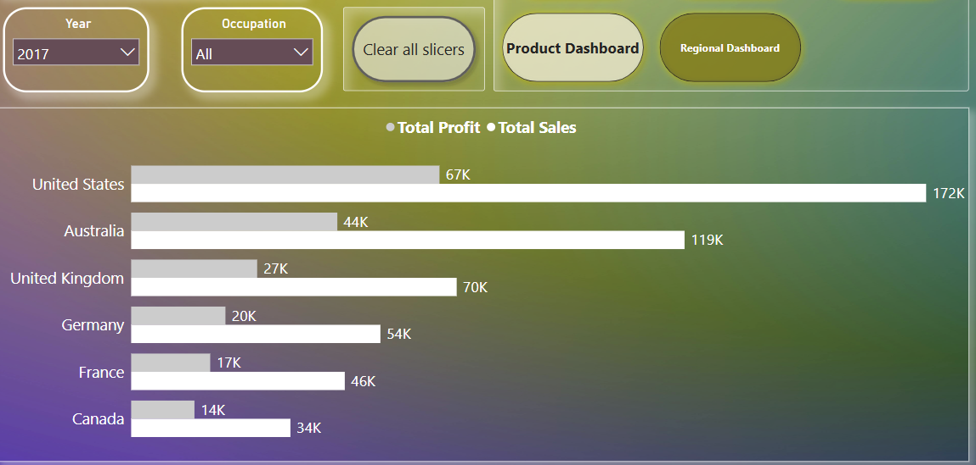
Regional Analysis part 2
- 2016, 2017, United States is highest sales and profit.
- Neil Armstrong

Slide 16
THANK YOU

